Slide 1
The USDA Enterprise Architecture Program
Niles E Hewlett, PMP CEA
Enterprise Architecture Team
USDA-OCIO
January 25, 2006

Slide 2
“We have an Enterprise Architecture --
We just can’t show it, explain it, share it,
tell you what’s in it, what it supports,
or who has what.”
-- Herding Katz

Slide 3
What You Need to know about EA
What is Enterprise Architecture?
What are the OMB Reference Models?
What is the EA Program in USDA?
The USDA EA Repository (EAR)
EA and Capital Planning
Summary

Slide 4
What is an Enterprise?
An enterprise is “The Business” of an organization
It has a broad scope (it touches…)
customers, staff, and contractors
the processes and assets used to develop and deliver products and services
the data and information held for use in the business
the mechanisms for providing communications and security
To understand an enterprise, we need to understand the mission, strategic objectives, and desired outcomes.

Slide 5
Concept of Architecture
Enterprise Architecture is not a new idea.
But EA requires some newer visuals in order to communicate.
Examples:
- a house blueprint
- aircraft systems design plans
- a community infrastructure
(communications, gas, electricity, water, roads, etc.)

Slide 6
Definition:
An Enterprise Architecture (EA) is a way of organizing an enterprise’s business processes, information needs, and supporting technologies.
EA includes the current state (“As-Is”), the vision of the future state (“To-Be”), and the transition plan of the business as well as technology.
It is another way of managing complexity…
(Not just an IT inventory)

Slide 7
Why Have an Enterprise Architecture?
To present the current & future vision of the business
To support quality decision making (investment choices) and the impact of changes.
To use information technology to support business operations in a cost-effective manner
Reduce redundancy
Reuse existing information and software components
Leverage new technology solutions effectively

Slide 8
And to ...
Promote the sharing of systems and data
Improve ability to integrate data across enterprise
Develop standards
Reduce number of application interfaces
Identify missing data and plan for its development

Slide 9
What Drives an Enterprise Architecture?
External environment (Legislation, OMB)
Clinger-Cohen Act, 1996
Mission of the organization
Business strategy (via strategic plans)
Business models (e.g., e-Gov initiatives)
Technology (including existing and new technologies)
Notes:
External Environment
Regulations at Federal Level that may change
Events such as 9/11 causing whole reshuffle of priorities and organizations
Administration changes
Weather – more fires
Labor pool

Slide 10
Layers of the Enterprise Architecture
Current federal guidance suggests thinking about “layers” of the enterprise architecture.
Business processes and activities use …
Business
Data that must be collected, organized, safeguarded, and distributed using …
Data
Applications such as custom or off-the-shelf software tools that run on …
Application
Technology such as computer system and telephone networks.
Technology

Slide 11
Practical Guide Circle as a Common Reference
Obtain
Executive
Maintain the
Buy
-
In and
Enterprise
Support
Establish
Architecture
Management
Structure
and Control
Use
the
Enterprise
Define an
Architecture
Architecture
Process
and Approach
Develop the
Sequencing Plan
Develop
Baseline
Develop
Enterprise
Target
Architecture
Enterprise
Architecture
Notes:
3 key elements – process, people, + tools
Seems like common sense; GAO EA CMM maps closely to this circle;
No one is doing it; will do a prototype test this summer on OCIO

Slide 12
What are the OMB FEA Reference Models?
Common classification schema for Federal Enterprise Architecture (FEA) – one language across Federal departments
Five evolving models (schema)
Performance Reference Model
Business Reference Model
Service Component Reference Model
Data Reference Model
Technical Reference Model
Together models create a framework for Federal decision making on IT investments
Notes:
Service Component Reference Model includes Applications

Slide 13
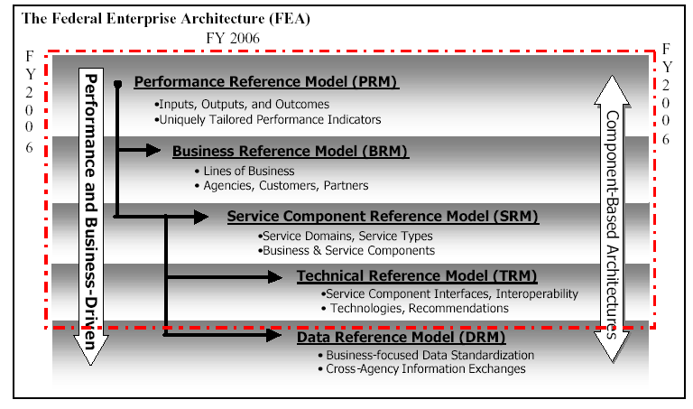
Federal Enterprise Architecture

Slide 14
FEA Reference Models
Performance Reference Model (PRM)
Framework to measure the performance of major IT investments and their contribution to program performance.
Business Reference Model (BRM)
Functional framework for describing business operations of the Federal government independent of the agencies that perform them.
Service Component Reference Model (SRM)
Framework that classifies service components with respect to how they support business and performance objectives.

Slide 15
Data Reference Model (DRM)
Model describes, at an aggregate level, the data and information that support program and business line operations
Technical Reference Model (TRM)
Component, technical framework used to identify the standards, specifications, and technologies that support and enable the delivery of services.
Also, a Security & Privacy Profile overlays all the ref models.
http://www.whitehouse.gov/omb/egov/

Slide 16
Who are EA Customers?
Agencies, USDA, and Federal Decision-Makers use Enterprise Architecture
to select investments that provide the highest value to the business
to identify unnecessary redundancy in data or systems
to identify opportunities for integration and reuse of data or systems.
Project Teams use Enterprise Architecture
for planning guidance to help build systems that will support USDA in the future
for technical guidance in developing projects.

Slide 17
USDA EA Framework
Foundation made up of FEAF layers - BDAT
Further categorized by domains
External portions of the architecture
(usually national or federal)
Common/enterprise USDA-wide portions
Agency portions
Views can be created by function, by customer,
or by time frame.
Notes:
There are also related architectures such as those of state governments, businesses etc.

Slide 19
USDA’s Architecture Transitions
Current Architecture
Target Architecture
Agency
Common
Enterprise-Wide
External/
Government-Wide
Agency
Common
Enterprise-Wide
External/
Government-Wide
Business Processes
Applications/
Services/ Data
Technology
Architecture Transitions:
Integration
Standardization
Sharing
Consolidated procurement

Slide 20
In addition…
We are using the The Open Group Architecture Framework (TOGAF) as the Department’s EA Methodology.
EA Program emphasis is on investment support systems, security and eGovernment projects.
EA Program Maintenance (data validation)
Agency stewards are being assigned to work with EAD staff to keep information current.
EAD reviews will be done to ensure compliance.

Slide 21
USDA Enterprise Configuration Control Board (ECCB)
ECCB was established in April 2004.
ECCB Responsibilities:
Establish and maintain enterprise architecture configuration control processes.
Recommend policy to CIO for adoption of enterprise-wide standards.
Review project architecture impact analyses as to effect on target architecture and transition plans.
Ensure consistency in agency-level architectures.

Slide 22
ECCB Goals
Establish department-wide EA configuration controls and strategies.
Identify and recommend changes regarding new enterprise-wide standards.
Work with the CIO to improve the maturity level of the architecture discipline within USDA.
Ensure department transition plans are aligned with changing business needs and strategic priorities.
Identify opportunities for Enterprise-wide
IT acquisitions.

Slide 23
USDA EA Governance Model
Agency
Common Enterprise Wide
External
E-Board
(Oversight)
Fed CIO
Council
Agency
CIO’s
IT Leadership Council
CIO
Agency
CCB
USDA
ECCB
Deputy CIO
Agency
Staff Off Architects
AIC
LOB and
Program Mgt
E-SCCB’s
(e.g., CFMS)
Assoc. CIO’s/IO
Assoc. CIO/ IRM
FEA PMO
IT Domain Arch.
Tech Rev Board (e.g., UTN)
Ext Standards
Groups
(e.g.,SAFECOM)
Program
Managers
EA Forum
Enterprise
Arch. Div.
Fed Arch Groups
(e.g., FM LoB, Fed Health, Nat’l Wildland Fire)
Project
Teams
EAR Users Group
Direct Authority
EA Governance Governance Boards
EA Guidance & Support

Slide 24
EA Performance Requirements
For the FY 2006, OMB is emphasizing
4 things:
Architecture completion
Architecture use
Architecture results
Architecture policy alignment.

Slide 25
EA Program - 2006
The EA Division
Has pre-populated the EA tool with C&A system data and CPIC investment information.
Has provided basic training of the content stewards.
Is currently migrating data to a newer version of the EA Repository (EAR).
Agencies
Over this past summer and fall, were updating, validating, and adding information in the EA tool with views of current and target architectures.
We have established a users group in support of the tool.

Slide 26
USDA EA Repository -- Adaptive
The EA Repository is being used to collect current & target architecture information:
Applications, Systems, & Component Information
Business functions, processes, and
Information Flow Diagrams
Data Models & Data Dictionary
External Interface Descriptions
Technical Designs
Data & Technology Standards

Slide 27
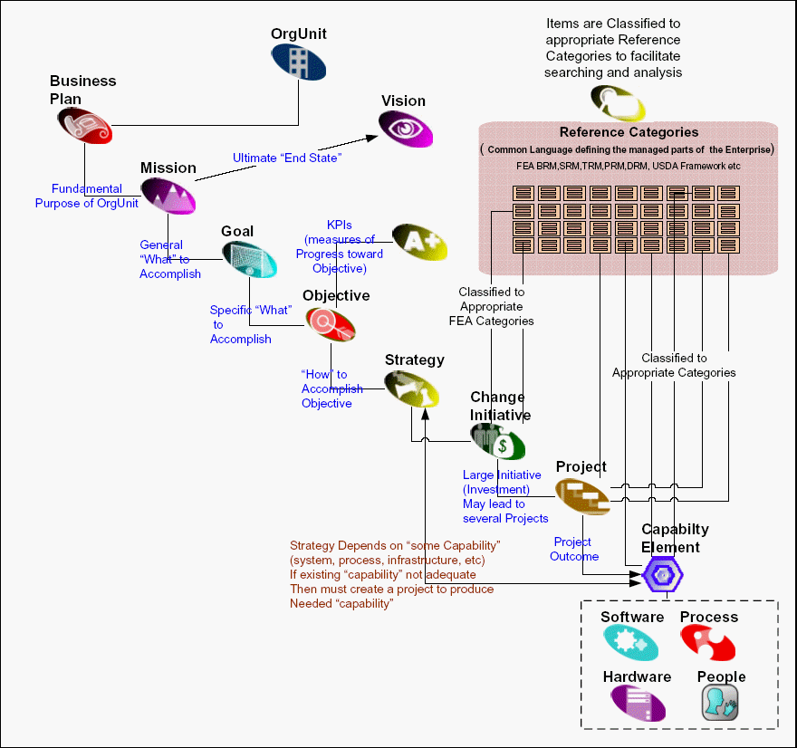

Slide 28
Overview of EAR Governance

Slide 29
Agency Architectures
Agency architectures are part of the USDA architecture (They will be regularly imported into central USDA architecture repository).
Agency architectures must include cross references to FEA framework (OMB reference models) for Federal decision making.

Slide 30
How can PMs use the EAR?
To develop system requirements aligned to the USDA Strategic Plan & Agency Plans
To identify similar systems – current/future
To develop project level architectures aligned with USDA’s EA.
To obtain information to support the projects business case.
Notes:
There are also related architectures such as those of state governments, businesses etc.

Slide 31
CPIC 300 Process and Enterprise Architecture
Project Office develops business
case (300) – prepares
justifications for any proposed exceptions to architecture
OCIO Review of Business Case –Includes review of Project Architecture Plan by EAD and preparation of Impact Analysis
E-Board
Decision
Project Office develops Architecture Plan for Project within
Repository
(Plan includes proposed applications and systems, standards to be used, explanation of why proposed technologies were selected, etc.)
Investment
Approved
Enterprise Architecture Updated (including approved exceptions)
Project Offices performs Initial architecture check for possible redundancy with existing systems/data, compliance with enterprise plans, and identification of relevant standards
Enterprise
Repository
Tool
(Holds Project Arch. Plans)
Business Need Identified and Documented
Start Here

Slide 32
How Does EA Support the Capital Planning Process?
Pre-select (Business Alignment)
Does investment fit the USDA target architecture?
Does the investment duplicate other USDA/Agency functions or processes?
Select (Business Alignment)
Are data design, hardware and software selections, security planning, and telecommunications design in alignment with existing standards and the target architecture?
If not, has the ECCB approved an alternative?

Slide 33
Control (Technical Alignment)
Is development in alignment with existing standards and
the target vision?
Evaluate and Steady State (Architecture Assessment)
How is the project architecture working?
Is an EA assessment included in Post-Implementation Review?
Are there plans for upgrades or retirement of the investment to meet the new, target architecture?
Are systems integration or interfaces being planned?
These are some of the questions being asked during the review
of waivers by OCIO.

Slide 34
How is USDA EA Built and Maintained?
It is built by Agencies and OCIO working together.
EA changes and the adoption of new standards are managed by the ECCB.
Investment oversight is provided by the E-Board.
(CIO and Business Executives)
EA compliance and alignment with target architecture and transition plans is assured through architecture reviews and the CPIC/waiver processes.

Slide 35
USDA EA Accomplishments
Established BPA support program
Developed an EA Concept of Operations
Established a Enterprise Configuration Control Board (ECCB) for governance
Selected an EA Repository (Adaptive)
Assisted with the establishment of EA Principles for the Department.
Currently, implementing the EAR and its
training program

Slide 36
Challenges to EA Success
The EA Program needs:
Sustained Senior Management commitment and $upport for the program and governance process.
A refresh of EA program and policy documentation to reflect changes in the EA Program – This is not the first EA effort that USDA has undertaken. (1997, 2000, 2003, 2006)
Agencies to commit time and resources to their EA program development and to the EA Repository.

Slide 37
Summary
Enterprise Architecture development is a best practice. It is more than just IT.
We do not do it just because it is required by law, regulation, or the CPIC process
We practice EA because the world is changing very rapidly; business is changing, and our technology decisions must support our business.
We need continued commitment at all levels to make USDA’s EA Program successful.

Slide 38
Thank you. Questions and Comments
niles.hewlett@usda.gov
(202) 205-3735

